Slide 1
Object Oriented Programming—C++ Lecture8 Template Functions
Qijun Zhao
College of Computer Science
Sichuan University
Spring 2025

Slide 2
Why do we want generic C++?
C++ is strongly typed, but generic C++ lets you parametrize data types!
● Ex. variable return type or input in a class (template classes)
Can we parametrize even more?
Can we write a function that works on any data type?

Slide 3
Template
A template is a mechanism for generic programming to provide a “schema” (or placeholders) to represent the structure of an entity
In C++, templates are a compile-time functionality to represent:
● A family of functions
● A family of classes
● A family of variables C++14

Slide 4
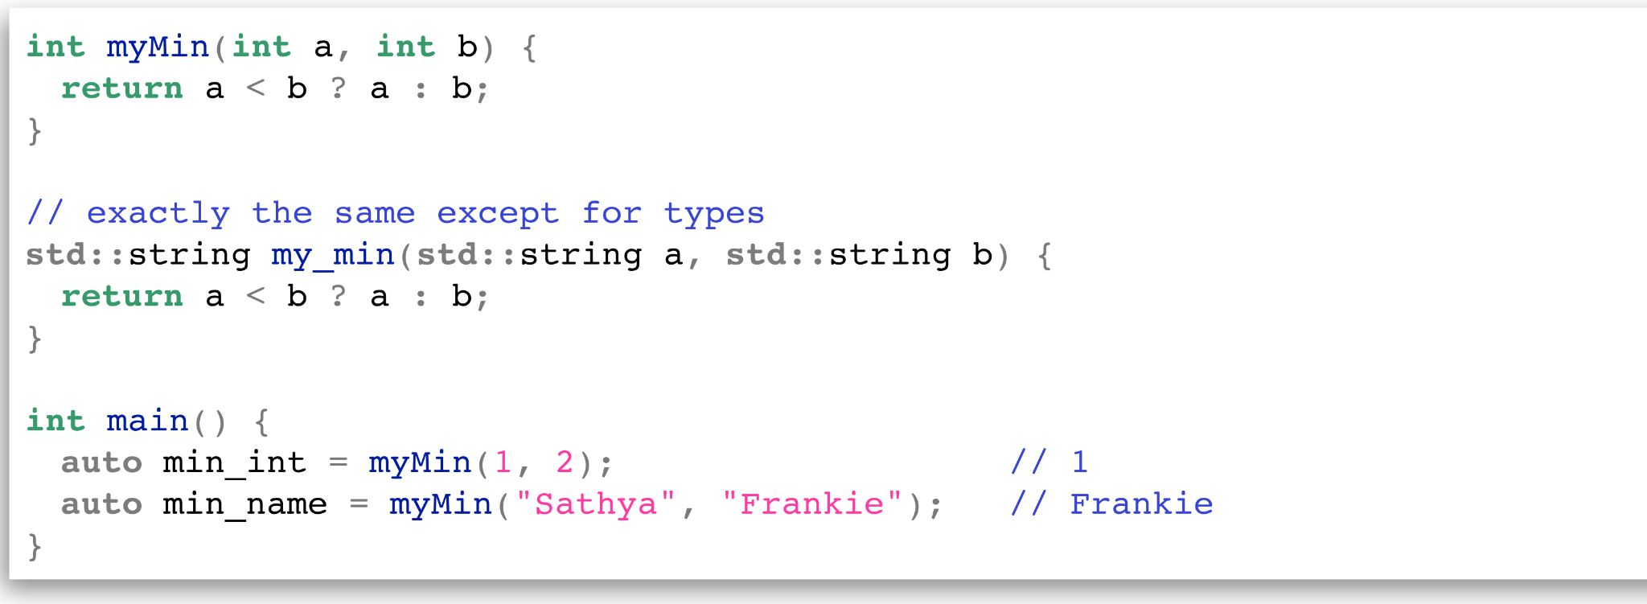
What about function overloading?
The problem: We want to define a function to handle different types
● Redundant code.
● If the user introduces a new type we have to write another function!

Slide 5
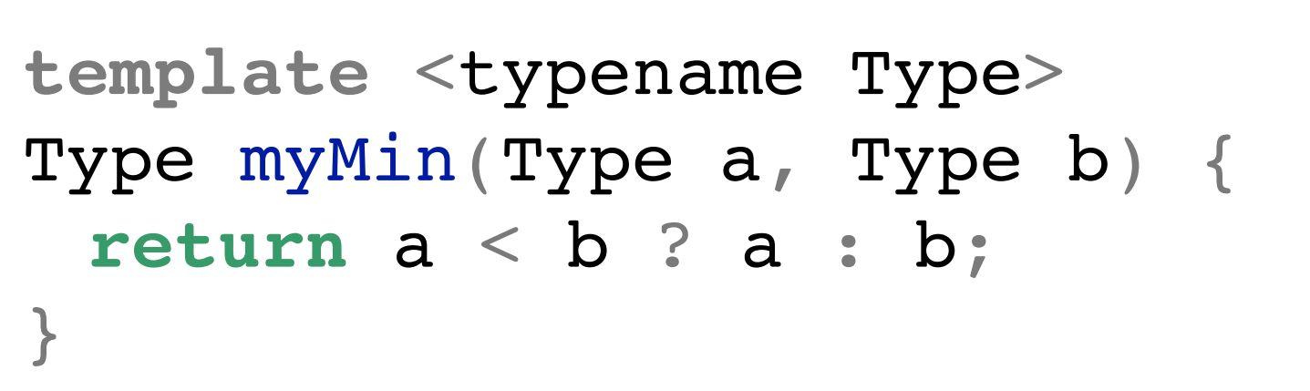
Function Template
Function Template
A function template is a function schema that operates with generic types (independent of any particular type) or concrete values
A function template works with multiple types without repeating the entire code for each of them:
Specifies that
Type is generic
List of your
template
variables
Indicating this
function is a template

Slide 6
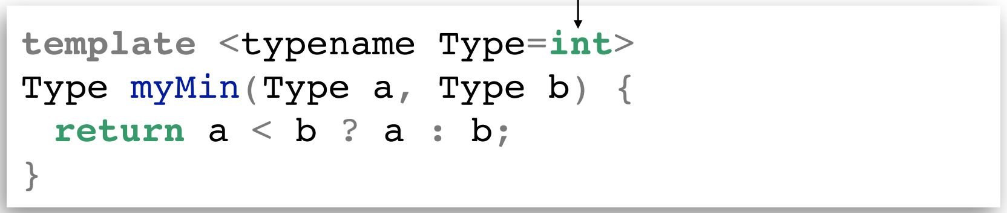
Default Types
We can define default parameter types!
What does it look like to use a template function?

Slide 7
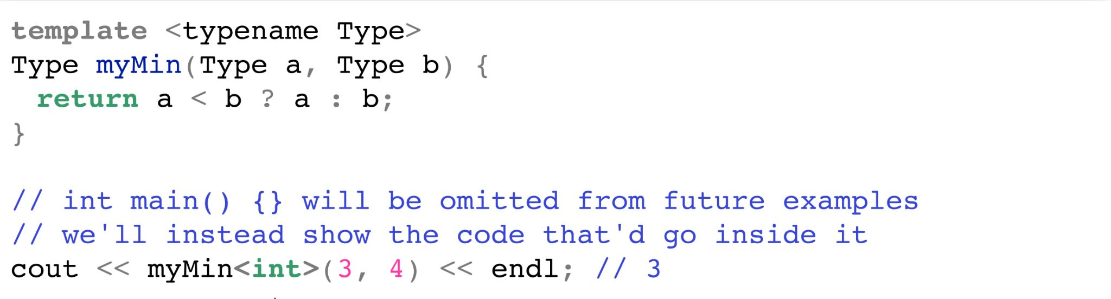
Calling template functions
Explicit Template Instantiation
Explicit template instantiation occurs when the compiler generates code depending only on the explicit template arguments specified in the declaration. Useful when dealing with multiple translation units to reduce the binary size
We can explicitly define what type we will pass, like this:

Slide 8
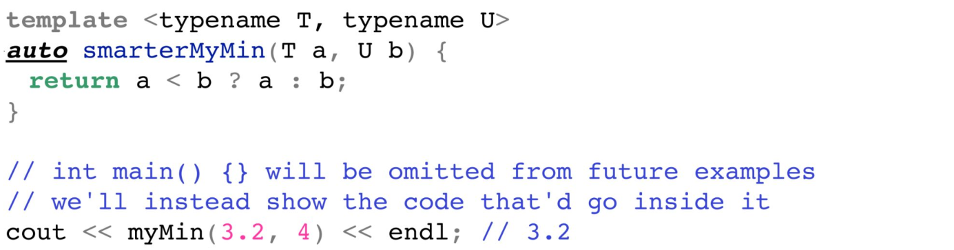
Calling template functions
Implicit Template Instantiation
Implicit template instantiation occurs when the compiler generates code depending on the deduced argument types or the explicit template arguments and only when the definition is needed
We can also implicitly leave it for the compiler to deduce!

Slide 9
Behind the Instantiation Scenes
Remember: like in template classes, template functions are not compiled until used!
● For each instantiation with different parameters, the compiler generates a new specific version of your template
● After compilation, it will look like you wrote each version yourself

Slide 10

Wait a minute…
The code doesn’t exist until you instantiate it, which runs quicker.
Can we take advantage of this behavior?

Slide 11
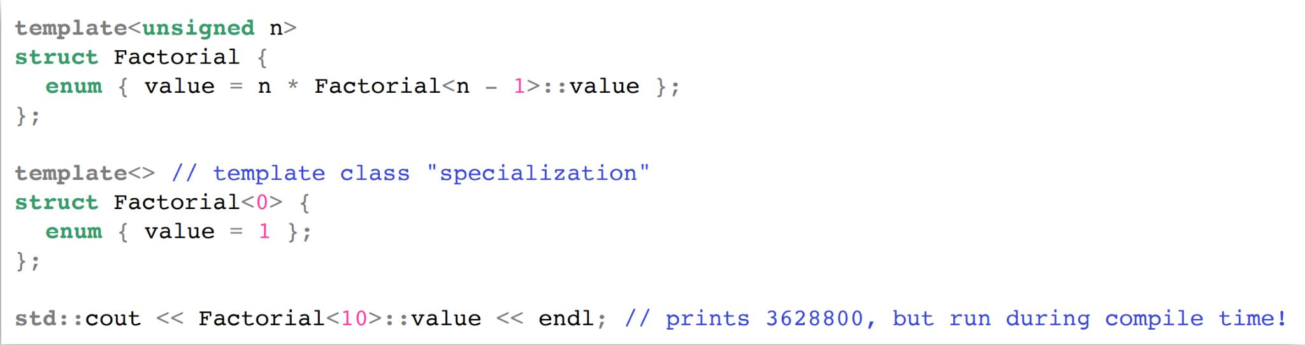
Templates can be used for efficiency!
Normally, code runs during runtime.
With template metaprogramming, code runs once during compile time!

Slide 12
How?

Slide 13
Templates: Benefits and Drawbacks
Benefits:
● Generic Programming: Less code and reusable. Reduce redundancy, better maintainability and flexibility
● Performance. Computation can be done/optimized at compile-time → faster
Drawbacks:
● Readability. “With respect to C++, the syntax and idioms of templates are esoteric compared to conventional C++ programming, and templates can be very difficult to understand” [wikipedia] → hard to read, cryptic error messages
● Compile Time/Binary Size. Templates are implicitly instantiated for every distinct parameters

Slide 14
Solving problems with generics
What if we wanted to count all the occurrences of a character in a string?
Or a number in a vector?
Or a word in a stream?
These are all the same problem!

Slide 15
Summary
● Template functions allow you to parametrize the type of a function to be anything without changing functionality
● Generic programming can solve a complicated conceptual problem for any specifics – powerful and flexible!
● Template code is instantiated at compile time; template metaprogramming takes advantage of this to run code at compile time

Slide 16
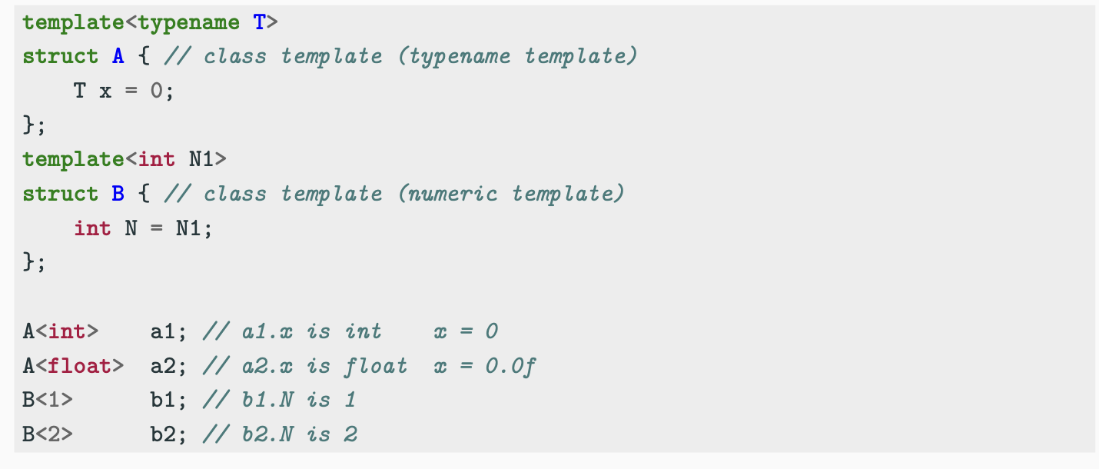
Class Template
Similarly to function templates, class templates are used to build a family of classes

Slide 17
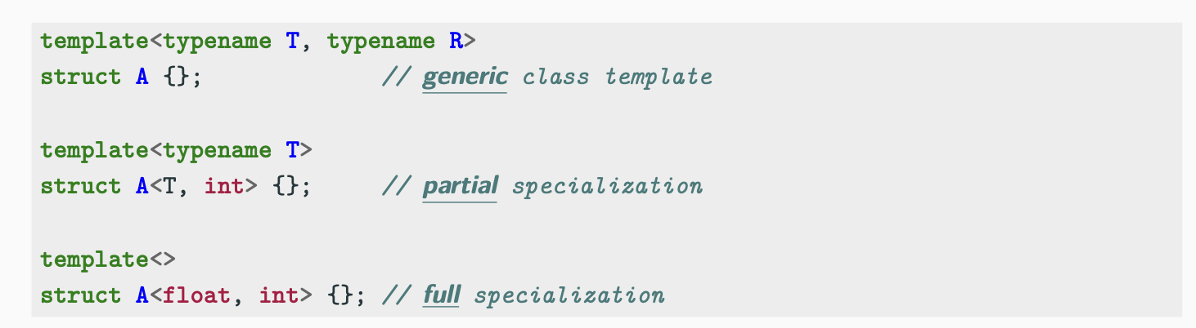
Class Template Specialization
The main difference with template functions is that classes can be partially specialized
Note: Every class specialization (both partial and full) is a completely new class, and it does not share anything with the generic class

Slide 18
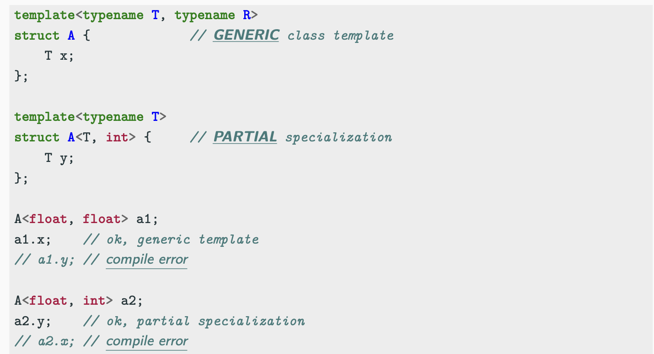
Class Template Specialization

Slide 19
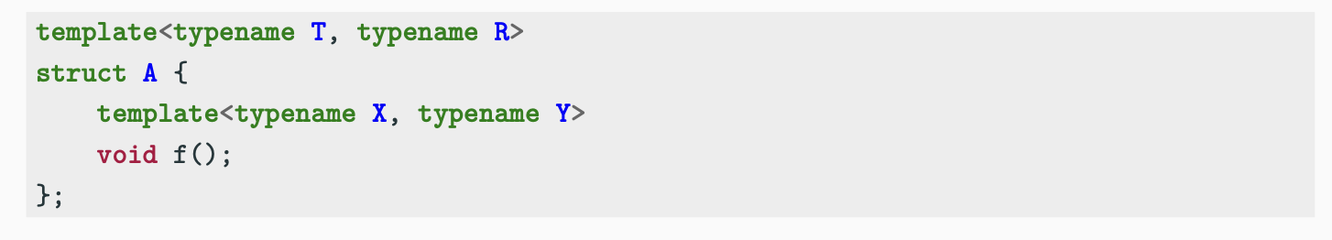
Class + Function - Specialization
Given a class template and a template member function
There are two ways to specialize the class/function:
● Generic class + generic function
● Full class specialization + generic/full specialization function

Slide 20
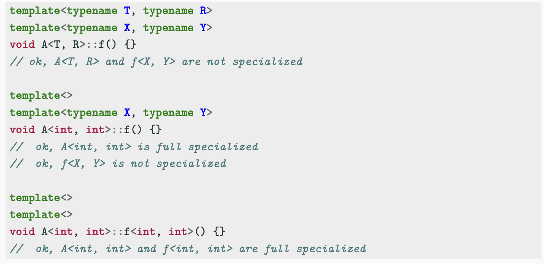
Class + Function - Specialization

Slide 21
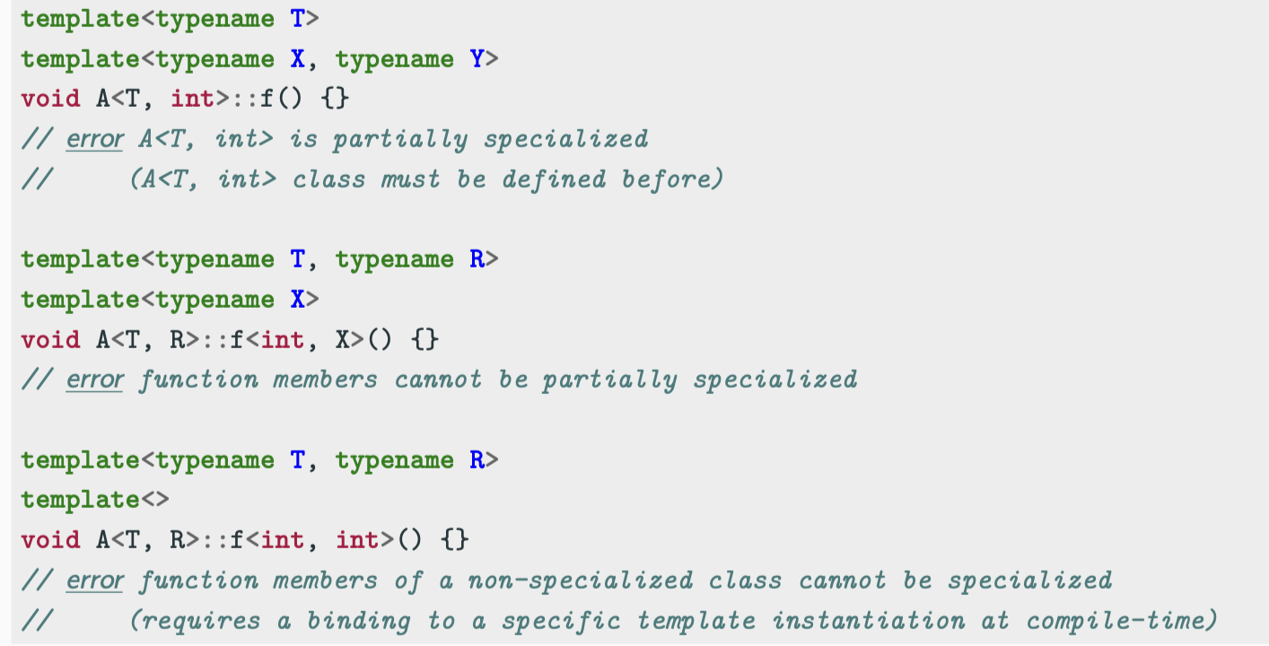
Class + Function - Specialization

Slide 22
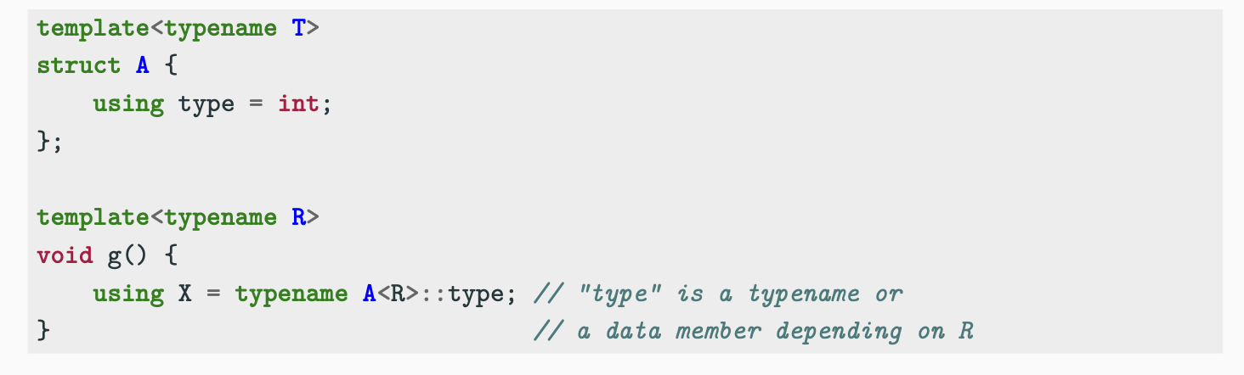
Accessing a Dependent Type - typename Keyword
Structure templates can have different data members for each specialization. The compiler needs to know in advance if a symbol within a structure is a type or a static member when the structure template depends on another template parameter
The keyword typename placed before a structure template solves this ambiguous

Slide 23
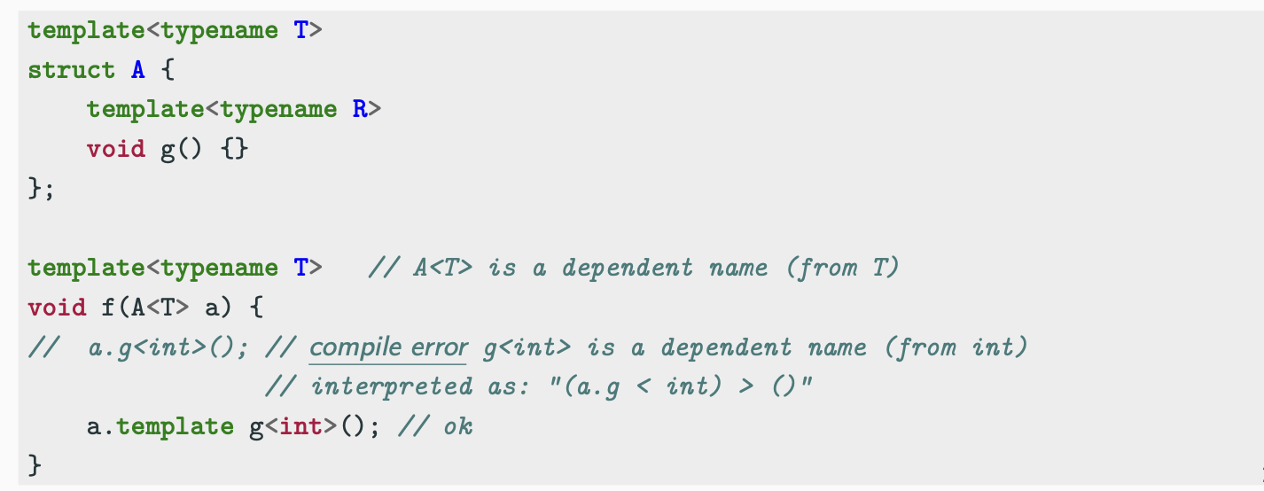
Template Dependent Names - template Keyword
The template keyword tells the compiler that what follows is a template name (function or class)
note: some recent compilers don’t strictly require this keyword in simple cases

Slide 24
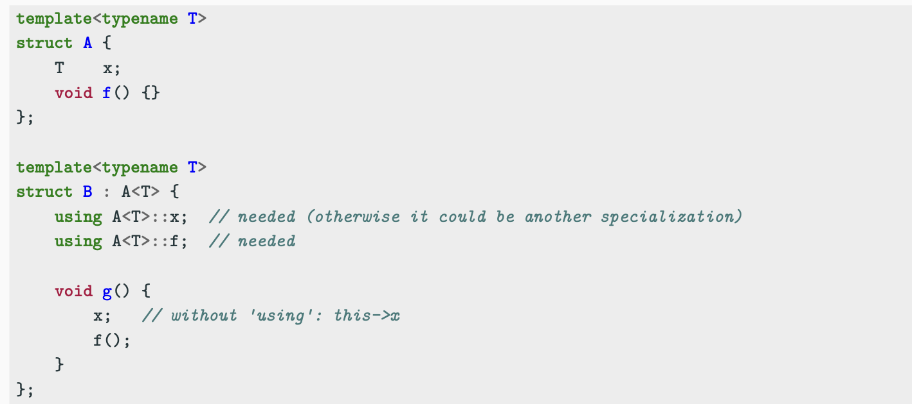
Class Template Hierarchy and using
Member of class templates can be used internally in derived class templates by specifying the particular type of the base class with the keyword using

Slide 25
virtual Function and Template
Virtual functions cannot have template arguments
Templates are a compile-time feature
Virtual functions are a run-time feature

Slide 26
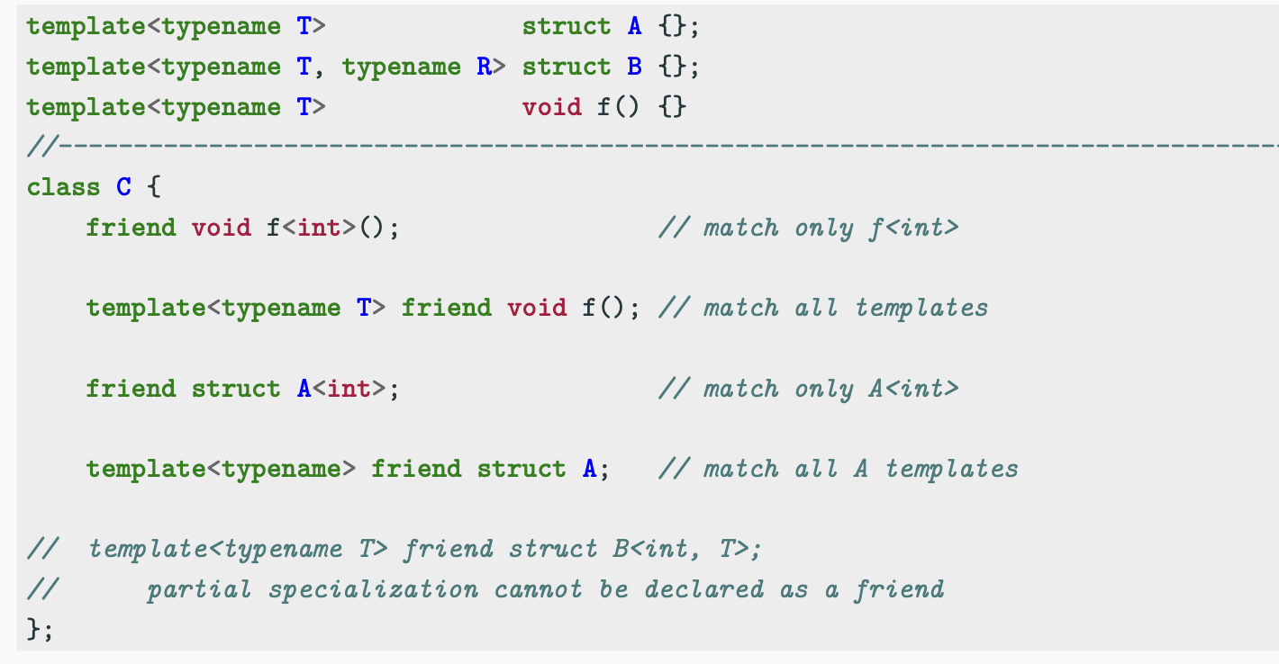
friend Keyword

Slide 27
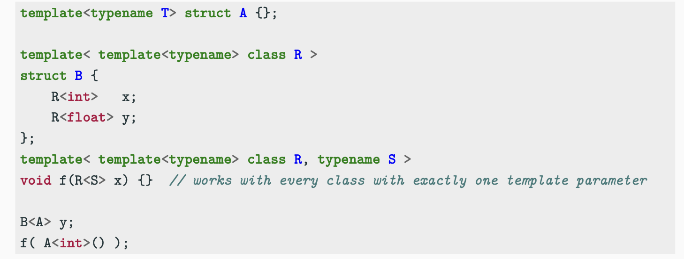
Template Template Arguments
Template template parameters match templates instead of concrete types

Slide 28
SFINAE
SFINAE
Substitution Failure Is Not An Error (SFINAE) applies during overload resolution of function templates. When substituting the deduced type for the template parameter fails, the specialization is discarded from the overload set instead of causing a compile error

Slide 29
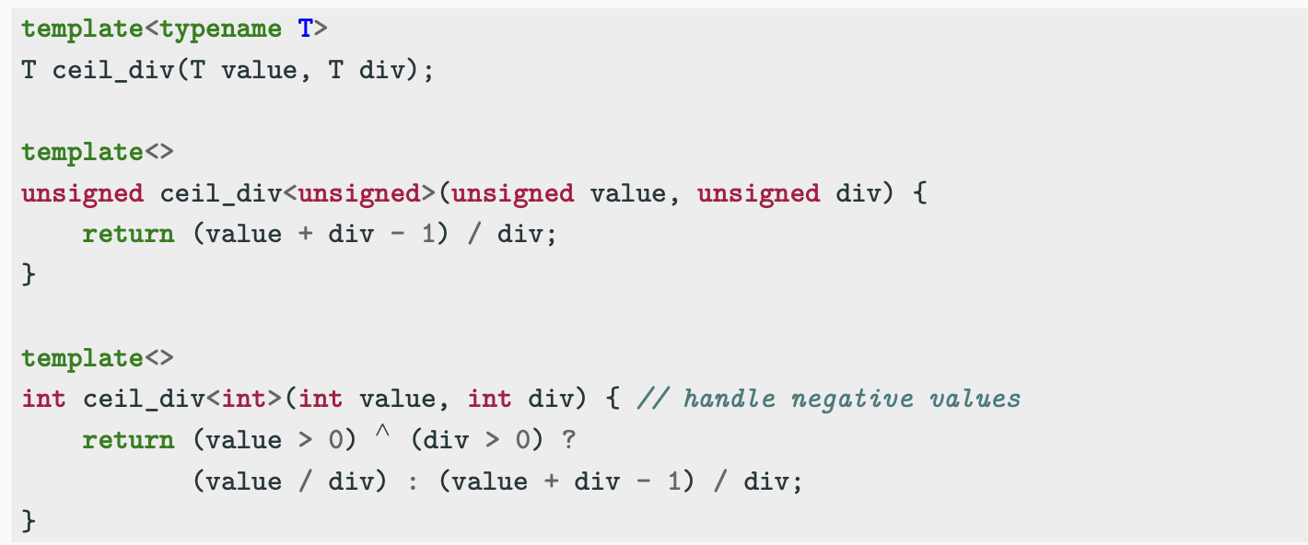
The Problem
For all signed and unsigned types (like long long, unsigned long long), they need different implementations.

Slide 30
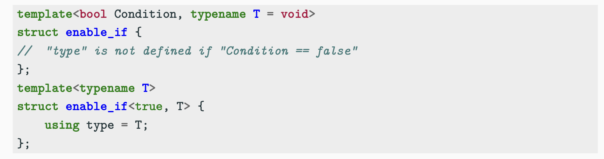
std::enable_if Type Traits
The common way to adopt SFINAE is using the std::enable_if/std::enable_if_t type traits.
std::enable_if allows a function template or a class template specialization to include or exclude itself from a set of matching functions/classes
helper alias: std::enable_if_t<T> instead of typename std::enable_if<T>::type

Slide 31
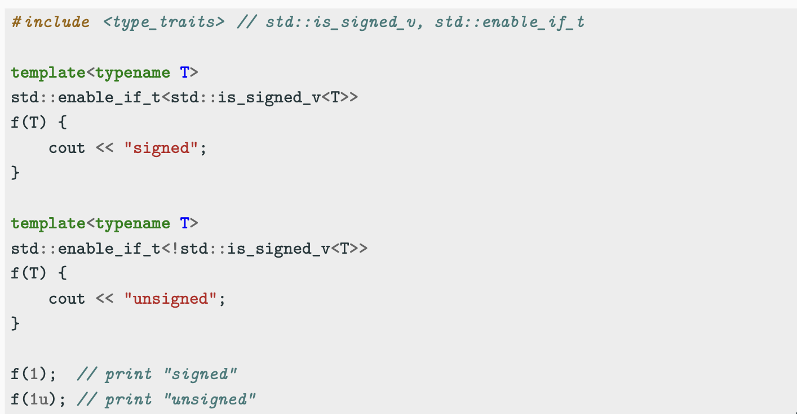
Function SFINAE - Return type

Slide 32
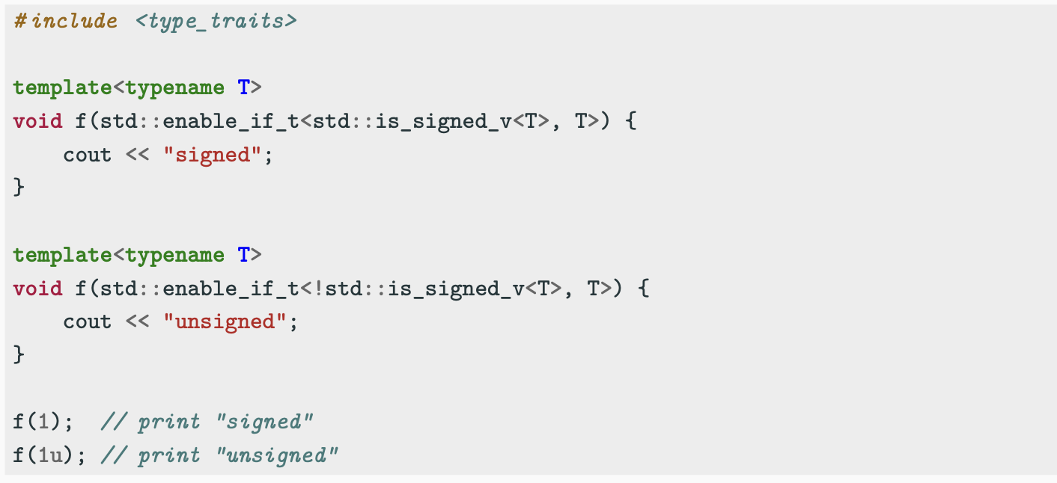
Function SFINAE - Parameter

Slide 33
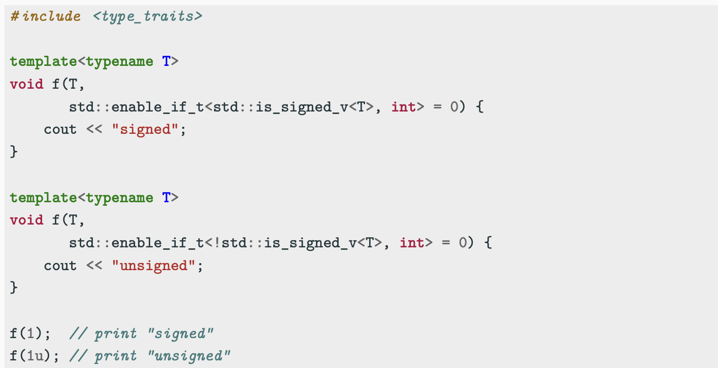
Function SFINAE - Hidden Parameter

Slide 34
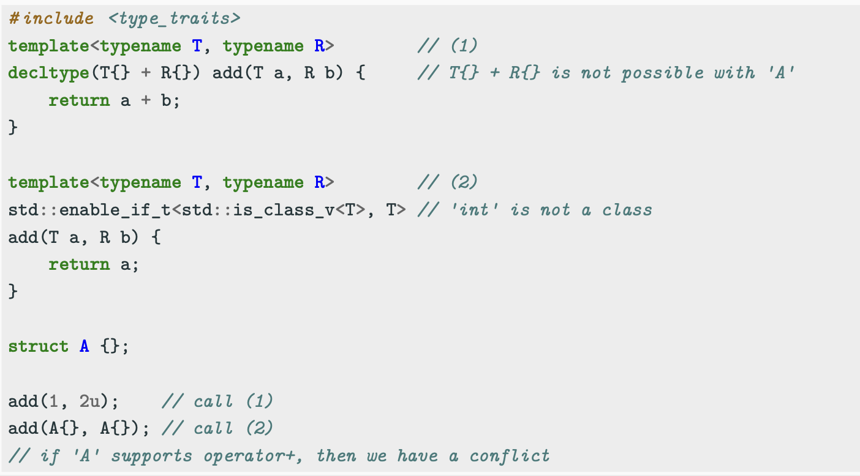
Function SFINAE - decltype + return type

Slide 35
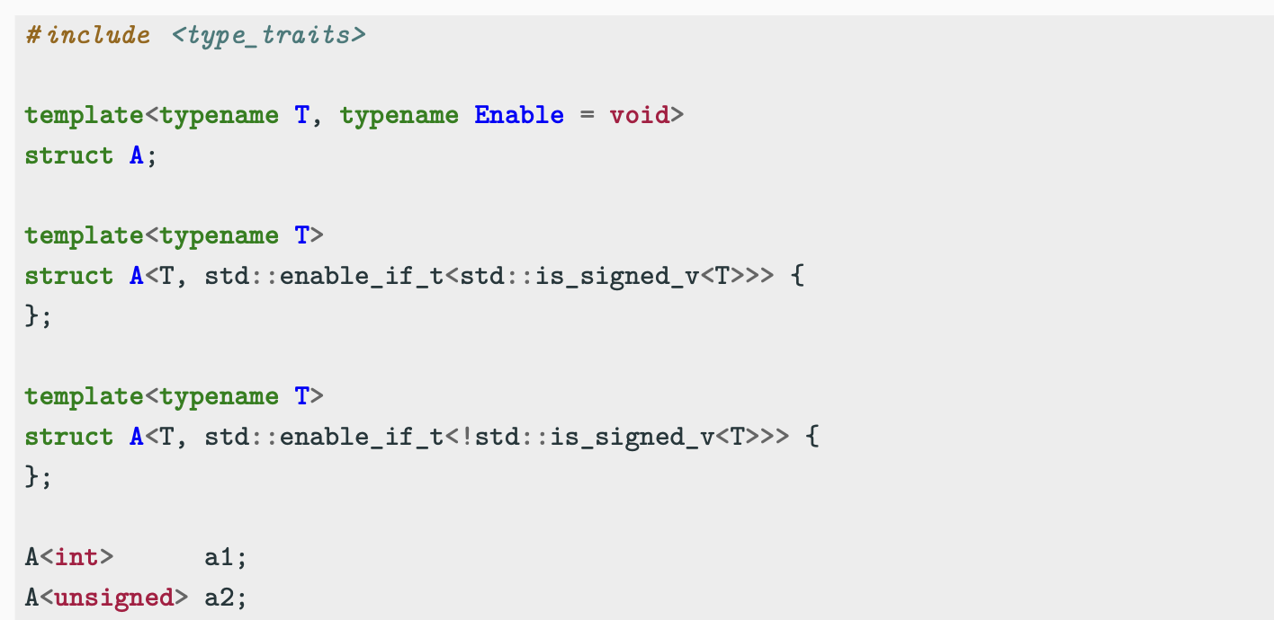
Class SFINAE

Slide 36
Variadic Template
Variadic template (C++11)
A variadic template captures a parameter pack of arguments, which hold an arbitrary number of values or types
● A parameter pack is introduced by an identifier TArgs prefixed by an ellipsis ... TArgs . Once captured, a parameter pack can later be used in a pattern expanded by an ellipsis …
● A pack expansion is equivalent to a comma-separated list of instances of the pattern
● A pattern is a set of tokens containing the identifiers of one or more parameter packs. When a pattern contains more than one parameter pack, all packs must have the same length

Slide 37
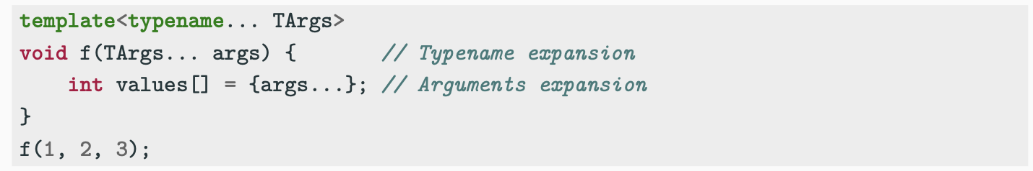
Variadic Template
● The pack TArgs expands in a template-argument-list, i.e. list of template arguments The pack args expands in an initializer-list, i.e. list of values
● The number of variadic arguments can be retrieved with the sizeof operator
● Parameter pack can be also used to create a homogeneous variadic function parameters
● Note: variadic arguments must be the last one in the declaration.

Slide 38
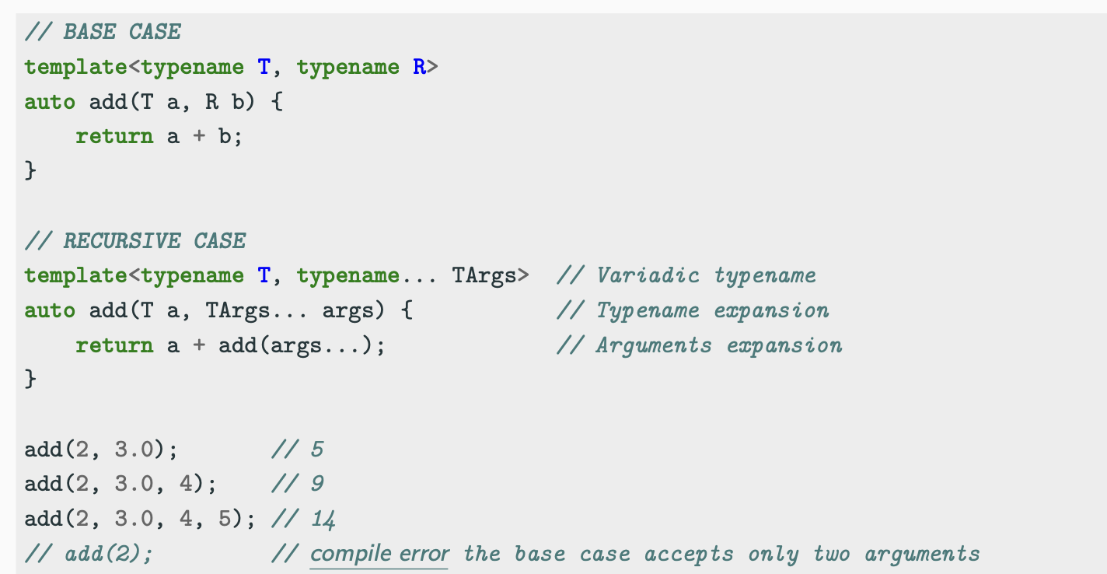
Example 1 Basic Unpack

Slide 39
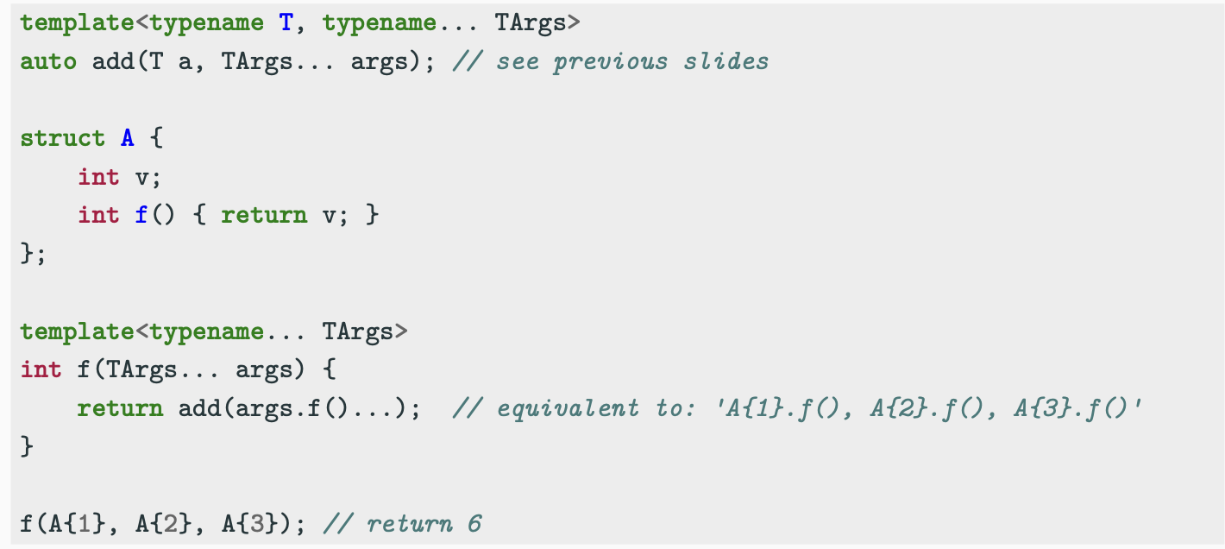
Example 2 Function Unpack

Slide 40
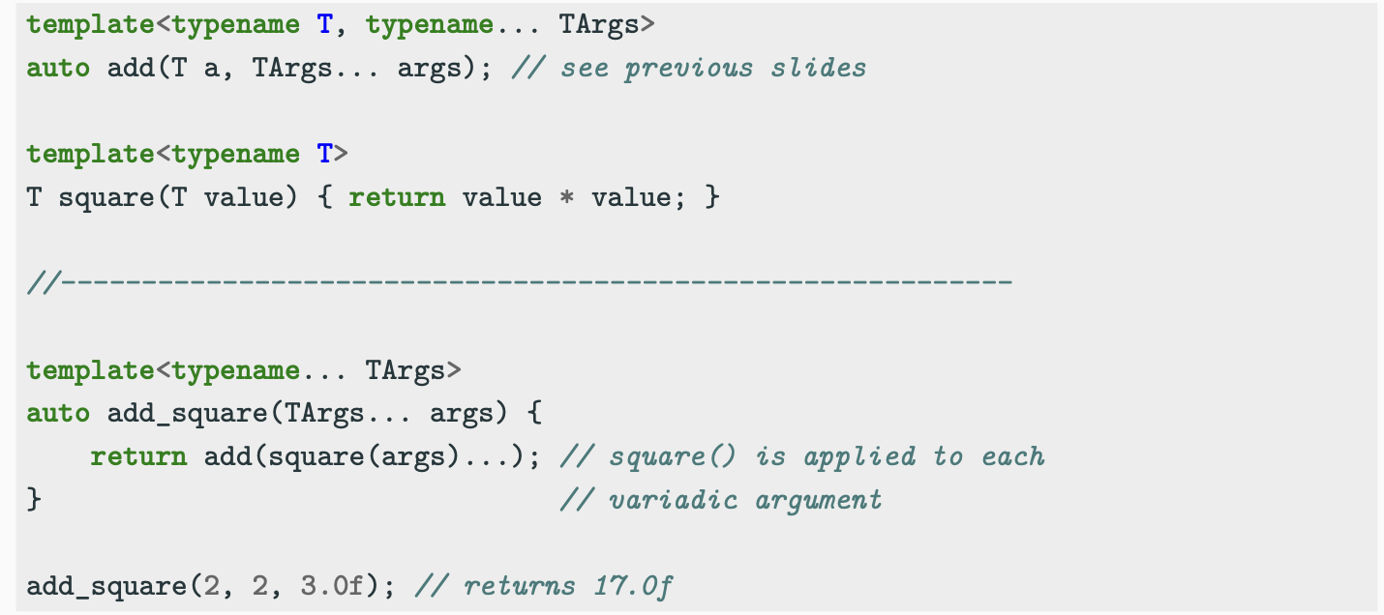
Example 3 Function Application

Slide 41
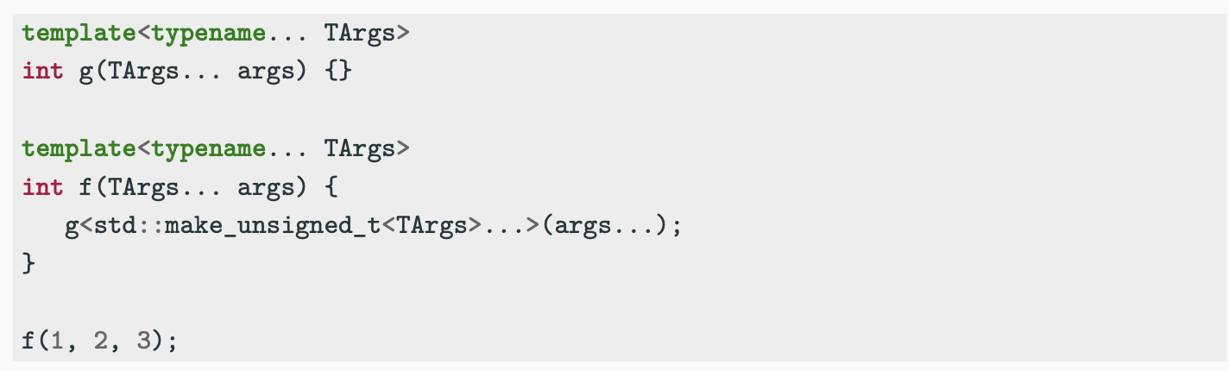
Example 4 Type Expansion

Slide 42
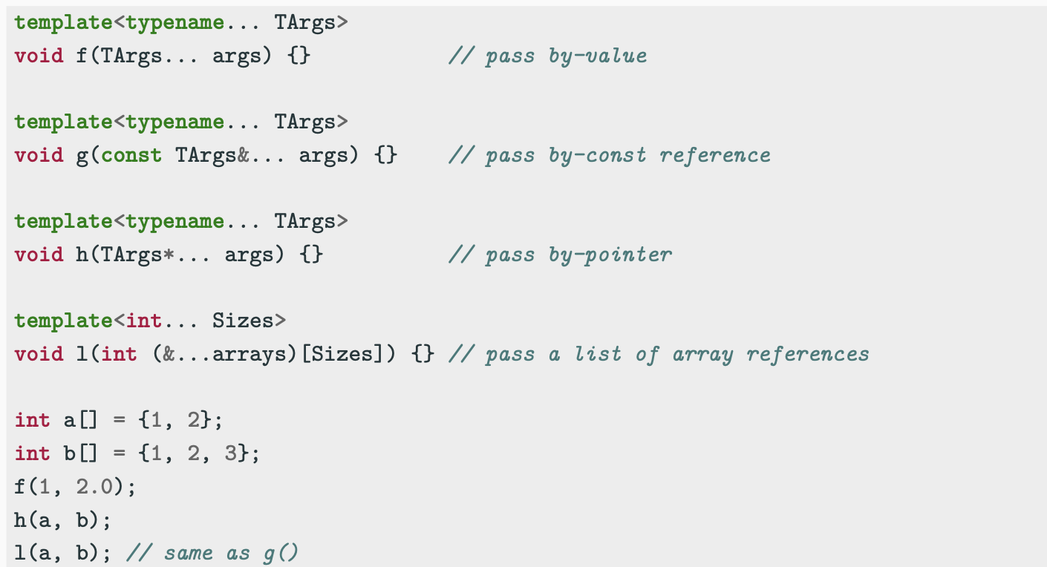
Function Initializer List Types

Slide 43
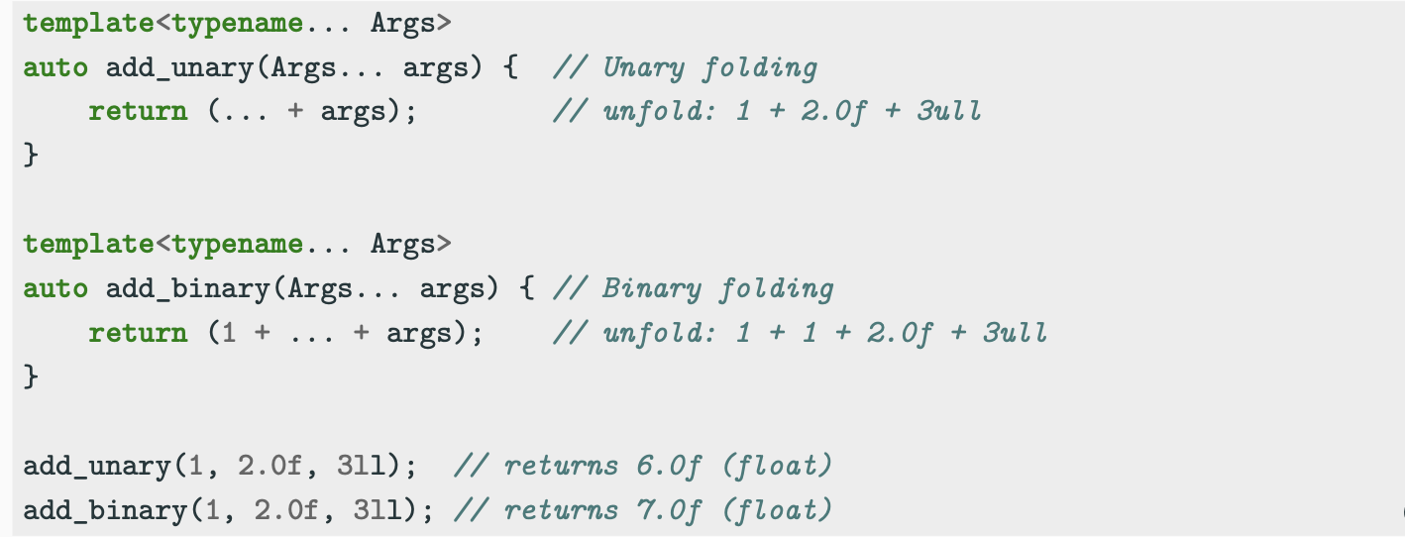
Folding Expression
● C++17 Folding expressions perform a fold of a template parameter pack over any binary operator in C++ (+, *, ,, +=, &&, <= etc.)
● Unary/Binary folding

Slide 44
Coding to make the world better
Qijun Zhao
qjzhao@scu.edu.cn

